Slide 1
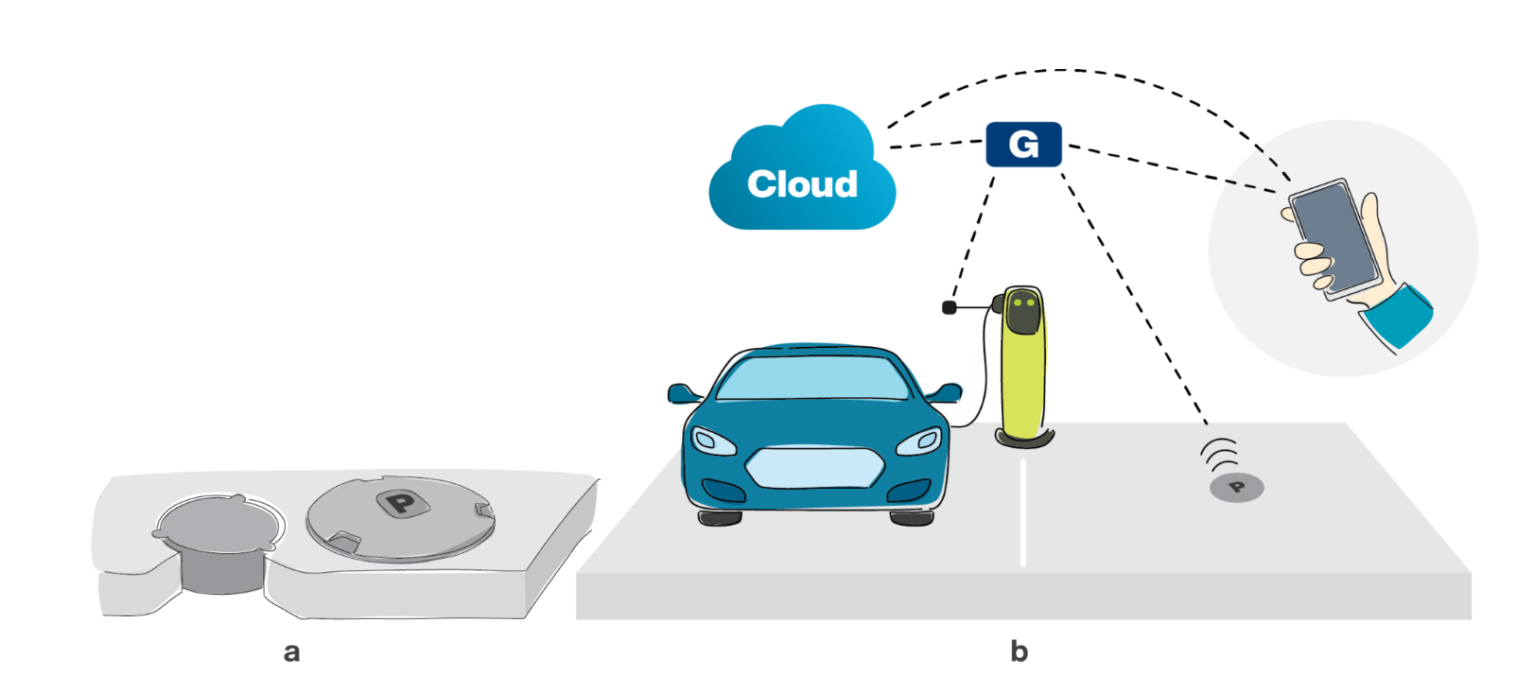
Smart Car Parking System
Based on IoT using Arduino UNO
Group 10
Sujata Saha (Project Co-ordinator)
Abhinai Lamgaday
Irfan Jawed
Nawazish Latif
Pratay Amrit
Anirban Mondal
Rohit Ghosh

Slide 2
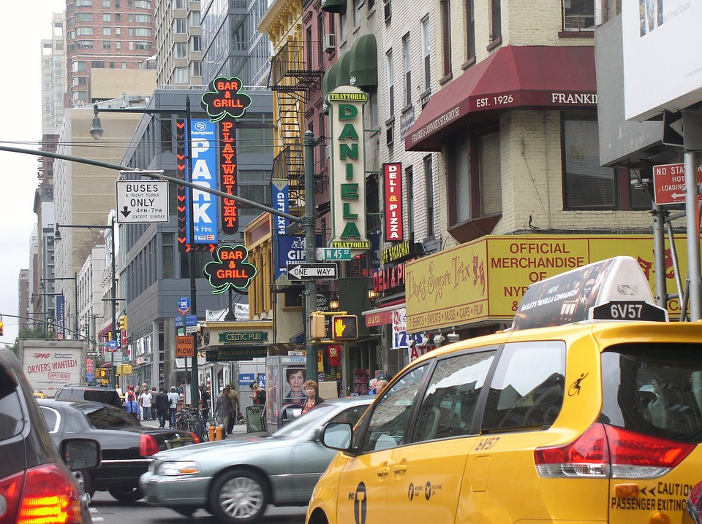
Introduction
Car parking is a major issue in modern cities of today. There are more vehicles on the road than parking spaces. This has led to the rise of the need for efficient parking management systems. Thus, we present before you the use of IoT based parking management system that allows for efficient parking space utilization.

Slide 3
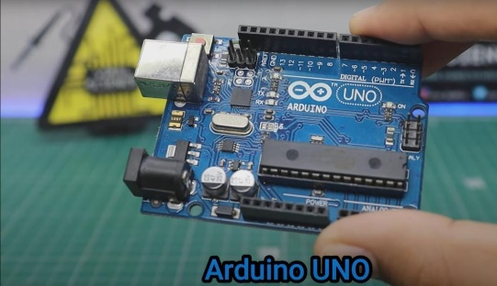
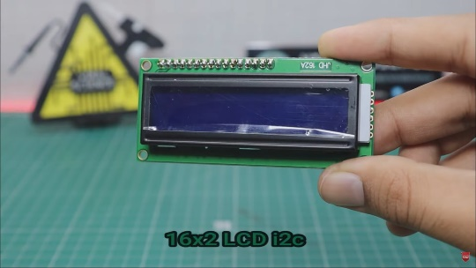
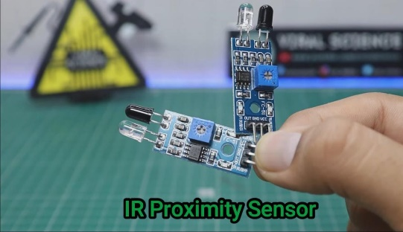
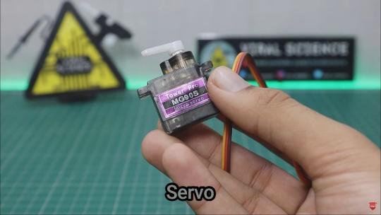
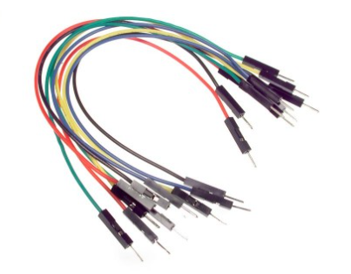
Components Required
16x4 LCD Board with I2c Module
Arduino UNO
IR Proximity Sensor
Servo Motor
Various Components are required to complete this project, such as:
Jumper Wires

Slide 4
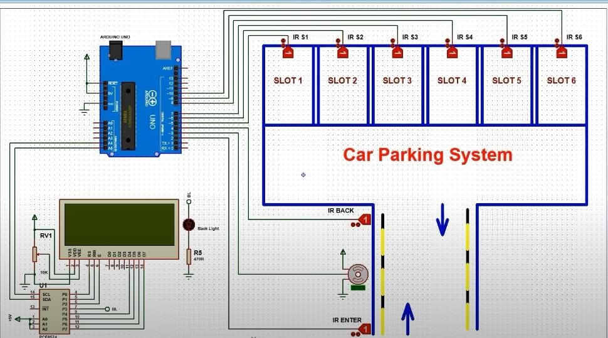
Circuit Diagram

Slide 5
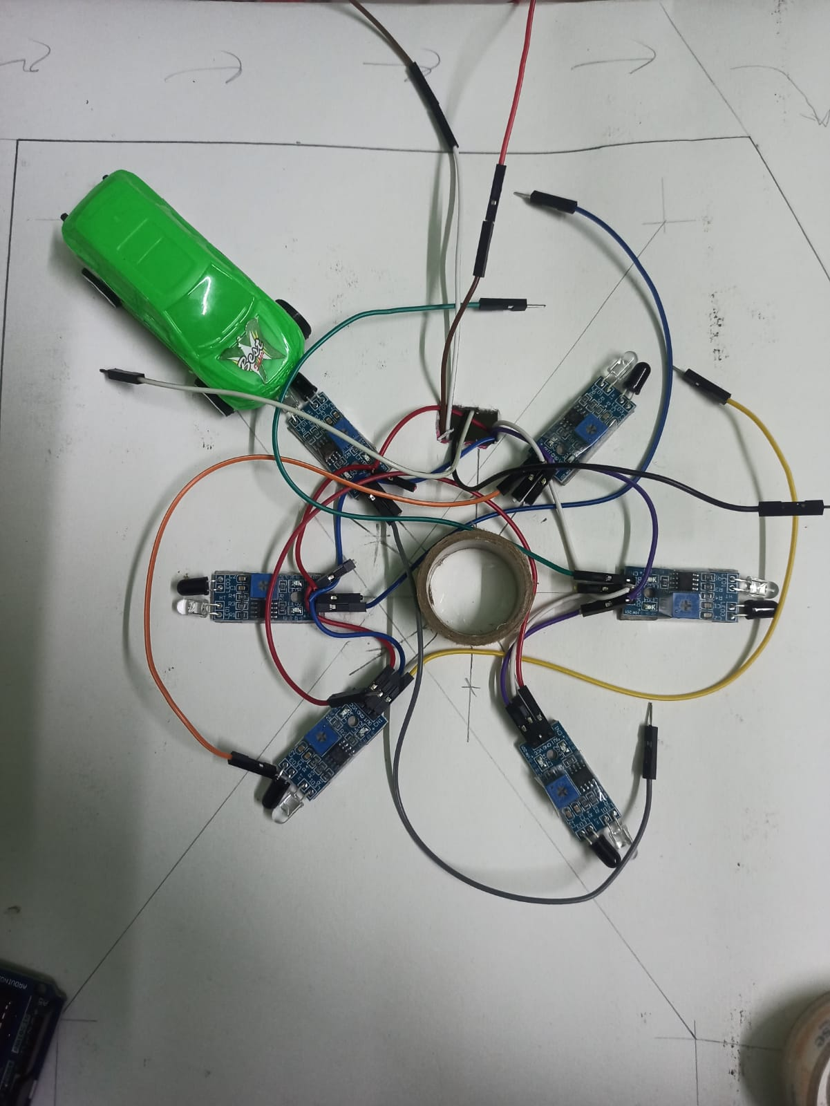
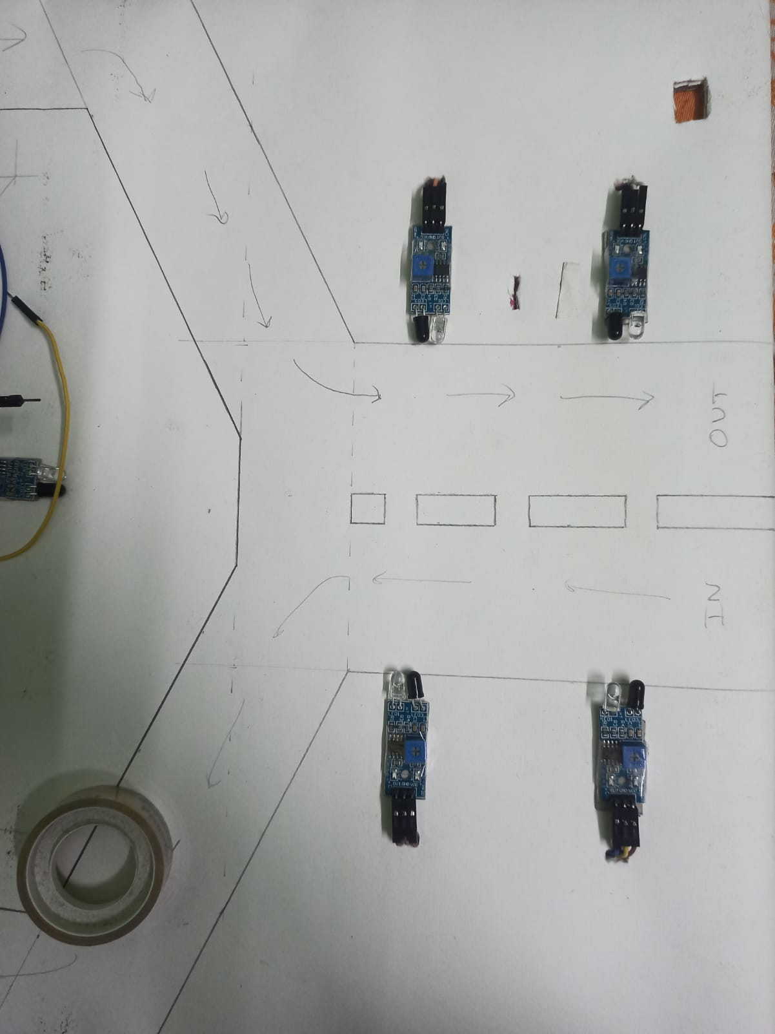

Slide 6
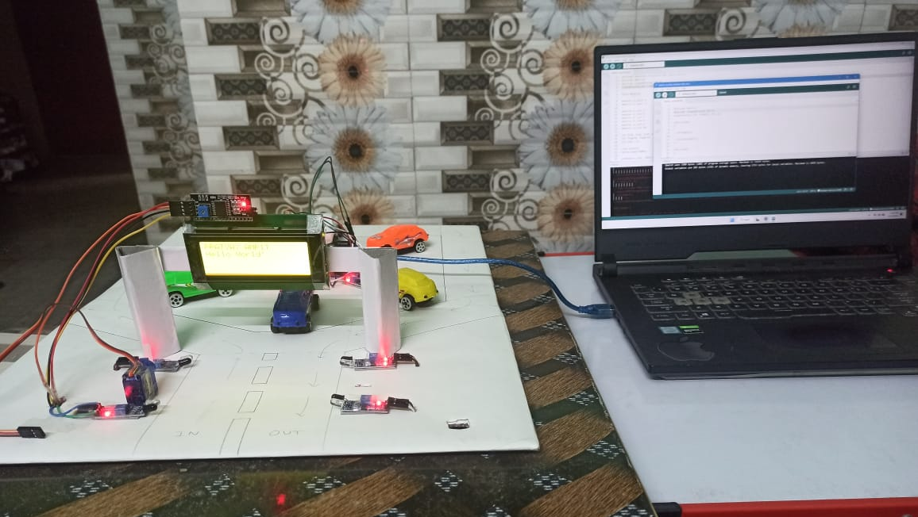

Slide 7
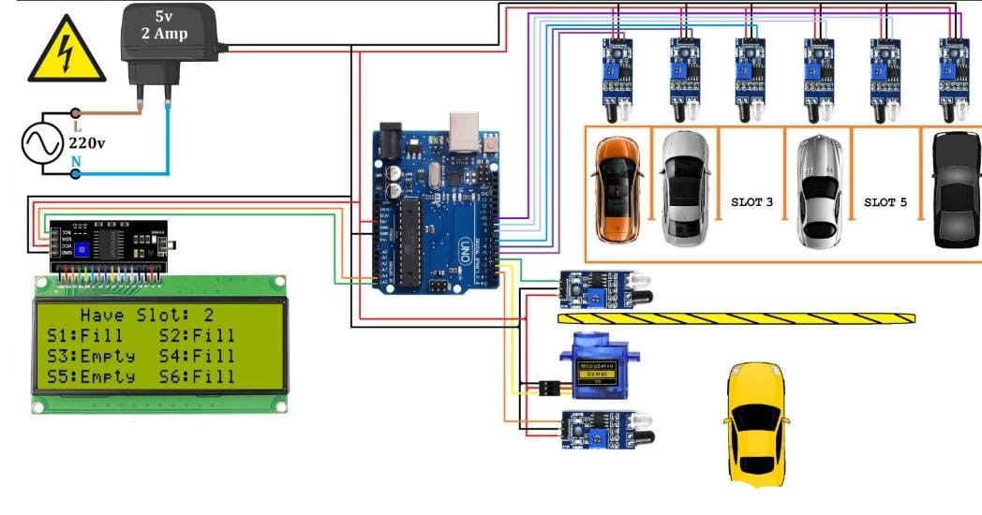
Working

Slide 8
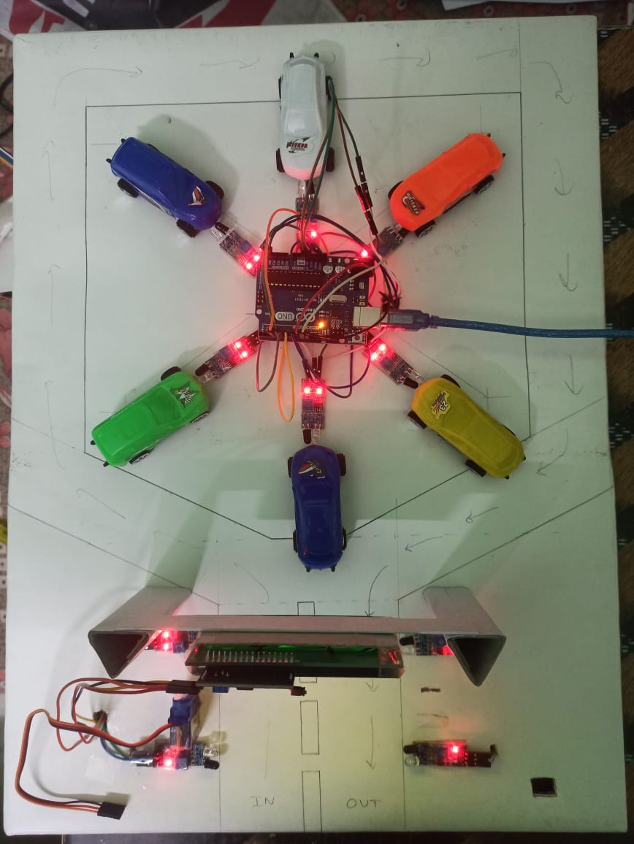
How it works
Step 1: Select a particular parking area.
Step 2: Browse through the various parking slots available in that parking area displayed on the screen.
Step 3: Select a particular parking slot.
Step 4: Once you have successfully parked your car in the selected parking slot, the screen will show filled space.
Step 5: If the parking spot is full and you tried to enter then a message will flash on the screen “FULL OF SLOTS” and the barrier will not open.

Slide 9
Literature Review
Smart Car Parking System, Aashish Joshi, Mubashir Hussain. (2020)
Working Principle of Arduino UNO. Leo Lewis (2016)
IoT, A Literature Review. R.Ramaswami (2015)
Arduino Based Smart Car Parking. Yogeshkumar Chaurasia (2021)
A systematic Literature Review on Arduino: Applications, Challenges, Advantages and Limitations. Hari Krishna Kondaveti (2021)

Slide 10
Conclusion
We would like to extend our deep appreciation to all my group members, without their support and coordination we would not have been able to complete this project.

